Slide 1
Automated Testing with Selenium IDE

Slide 2
Components of Selenium Suite
Selenium IDE
-- Record and playback automation tool
-- Automate the web applications.
-- Chrome, Edge and Firefox browser extension -- People with no or limited programming language experience
2. Selenium RC
-- Selenium Remote Control(RC)
-- Inject the javascript code in the browser for automation
-- Required an additional server for running the automation scripts -- Limitations
Slow
No headless browser

Slide 3
Environment Setting (IDE)

Slide 4
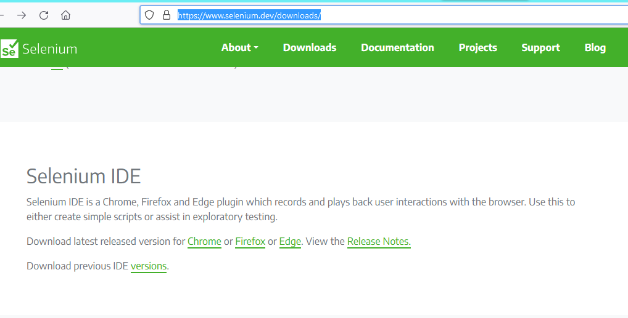
Open Firefox, download the IDE
https://www.selenium.dev/downloads/

Slide 5
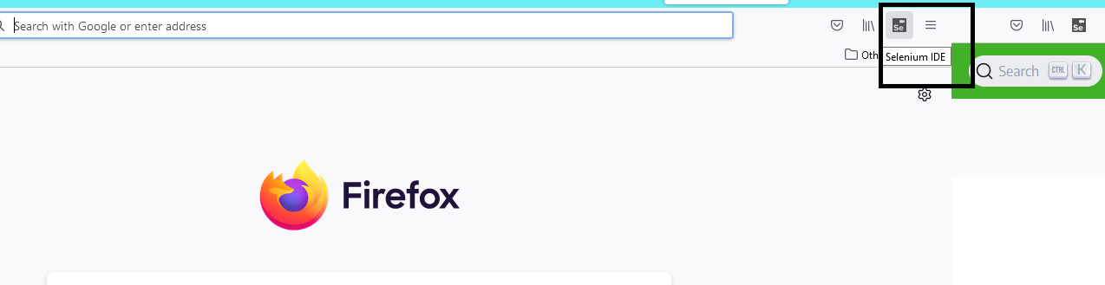

Slide 6
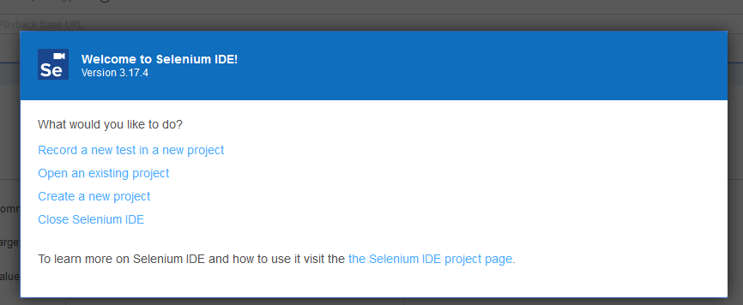

Slide 7
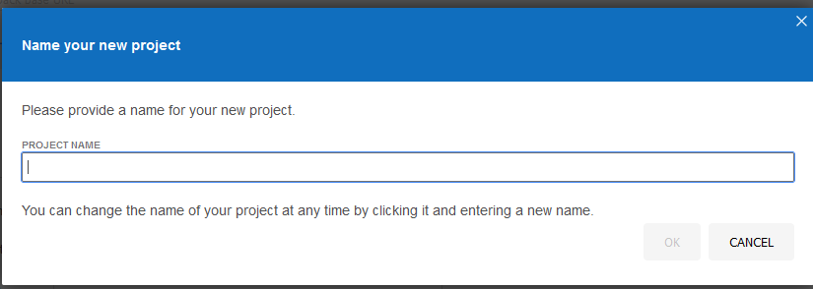

Slide 8
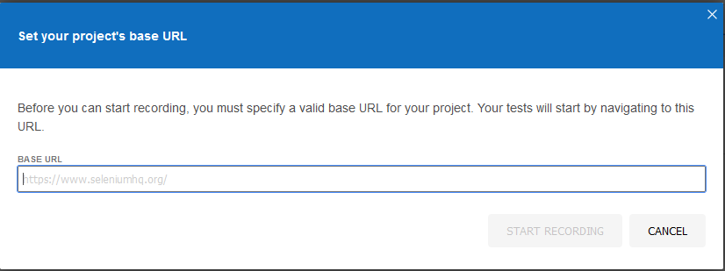
https://accounts.google.com

